Slide 1

FDR2022
International Topical Workshop on Fukushima Decommissioning Research
Oct 14-16, 2022. J-Village, Naraha, Fukushima, Japan
GEOLOGICAL DISPOSAL OF FUEL DEBRIS?
COMPARISON OF THE INTERACTION OF FUEL DEBRIS AND OF SPENT NUCLEAR FUEL WITH WATER
B. Grambow Prof. Emérite IMT Atlantique/SUBATECH Nantes
Former director of SUBATECH and
group leader at the advanced science research center at JAEA

Slide 2
Reviev paper:
Grambow, Nitta,
Shibata, Koma,
Utsunomiya,
Takami, Fueda,
Ohnuki, Jegou,
Lafolley, Journeau
2021
Spent fuel leaching studies in water since 1975 with the intention to study the option of direct geological disposal of spent nuclear fuel
Analyses of couling water of Fukushima reactors to deduce form the evolution of actinide and fission product concentration on fuel debris behavior in water
Fuel debris behavior under geological disposal condtions
This paper
Confinement options

Slide 3
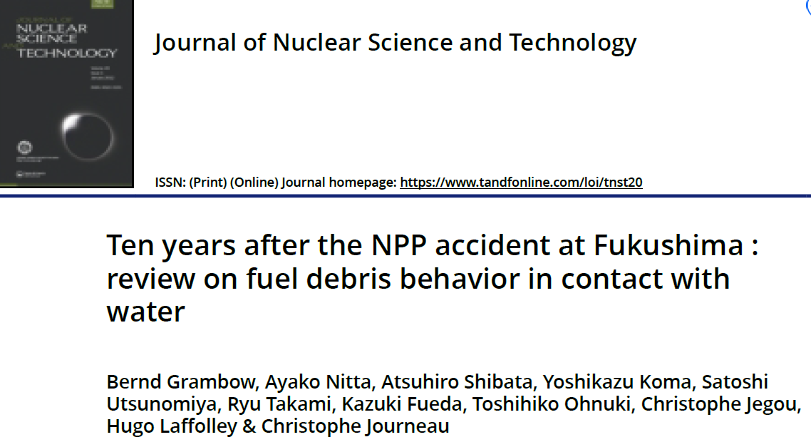

Slide 4
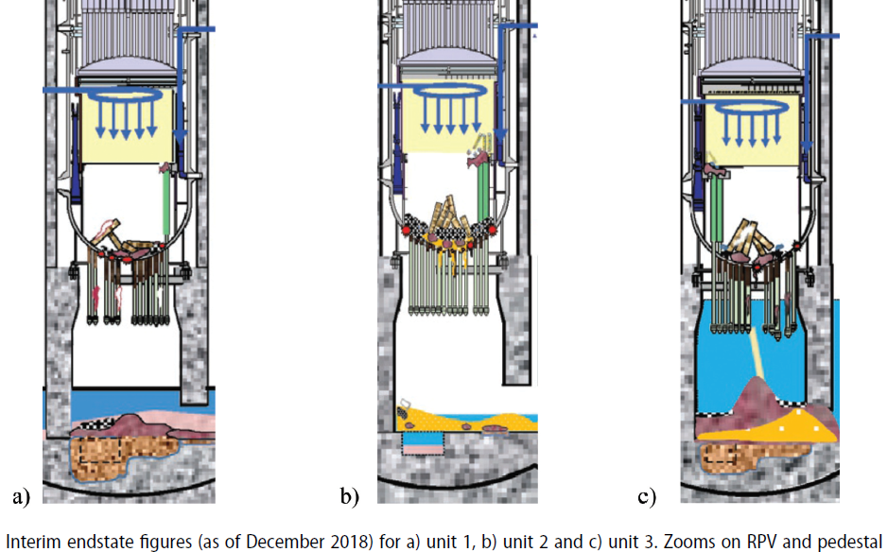
Fuel debris location in the 3 reactors

Slide 5
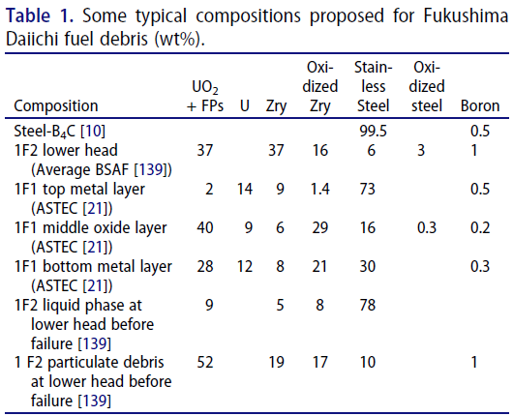
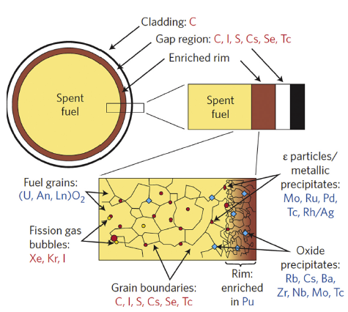
Fuel debris composition Spent fuel

Slide 6
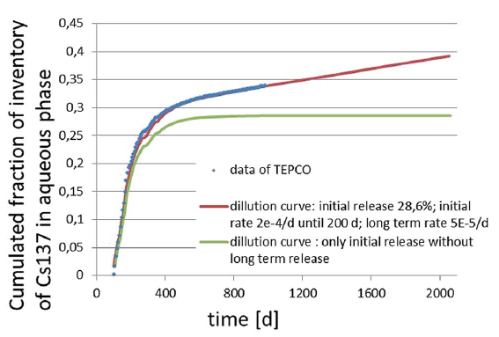
Permanent couling of fuel by cleaned recycled water
A giant leaching device
Analyses of collected water by Tepco

Slide 7
Atoms of ^{134/137}Cs, ⁹⁰Sr or ¹²⁹I are released from the fuel debris in the reactor into the cooling water million to hundred million time faster than the atoms of actinides like Uranium or Plutonium
A similar but less extended effect has been observed in spent fuel disposal studies, when putting decladded spent nuclear fuel in experiments in water. This fraction of fast released radionuclide consists of similar elements, mainly of ^{134/137}Cs, ¹²⁹I, etc. It is called IRF, “instant release fraction”
Permanent cooling of fuel debris consists in permanent leaching (removal) of the inventory of mobile elements from the debris.
The release rates of mobile elements decrease with time, as the most mobile fractions are washed out

Slide 8
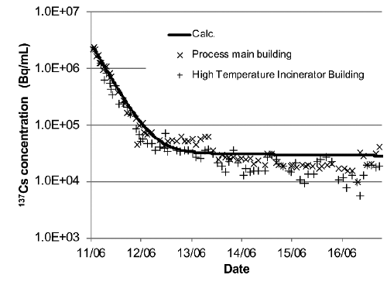
Temporal evolution
The release rate of Cs from the fuel debris in the reactors has been decreased by a factor of 100, indicating that the fuel debris becomes over time more stable (less release) in water, as the instable fraction is washed out

Slide 9
After leaching (removal by action of water) of the mobile fraction, the residual fraction shall be more stable than spent fuel
The stability of spent fuel in water is assessed in Sweden, Switzerland and Finland to be larger than million years
It stems from the stability (low solubility) of the UO₂ matrix, not from an additional barrier
The Instant release fraction IRF of spent fuel
  Leads to higher initial release, but has smaller long term effect in geological disposal
Some fuel debris contain chemical elements, which are favorable to its stability in water over time,
  such as Zr (low solubility and no oxidation),
  rare earths, and
  actinides,
  Si, Ca or iron
Fuel debris shall be at least as stable in water as spent fuel , if not more

Slide 10
Near field isolation of radiotoxicity in the geosphere during disposal
A key safety indicator: reducing conditions
isolated
isolated
Isolation until decay
Isolation until decay
Isolation likely until decay
Isolation until decay
Conc. < natural
Slow release to far field
Isolation until decay
Slow release to far field
isolated
isolated
isolated
B. Grambow, Mobile fission and activation products in nuclear waste disposal, Journal of Contaminant Hydrology, (2008) 102, 180-185

Slide 11
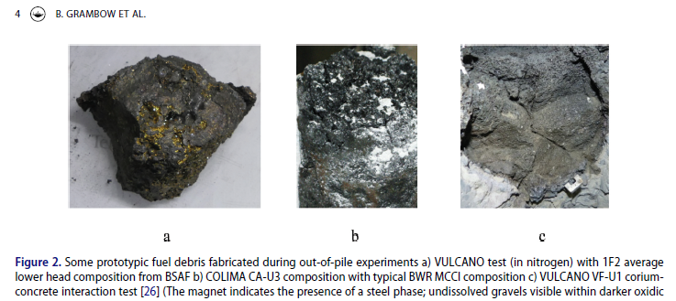
Actinides are very insoluble, limiting release from the debris, despite surface area is probably much larger than of spent fuel (in case of solubility control of release, surface area is not so important)
Reducing geochemical conditions further decrease solubility of U, Pu, Np,while solubilities of Am and Cm remain low

Slide 12
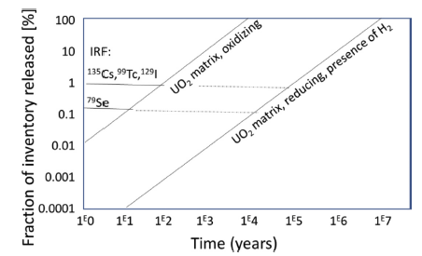
General simplified source term model for radionuclide release from spent fuel
Distinguishing labile nuclides (« Instant release fraction », IRF; few % ¹³⁵Cs, ⁷⁹Se, ¹²⁹I, ³⁶Cl…) from UO₂-matrix bound RN (the rest of Cs, I, Se, the total of actinides +Tc inventories…)
Important to assure reducing geochemical conditions (absence of oxygen) for disposal of fuel debris

Slide 13
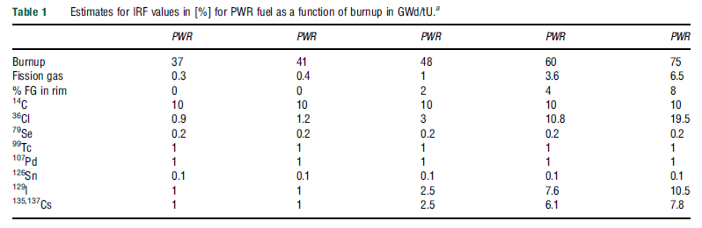
IRF increases with burnup and linear power (fuel temperature)
In fuel debris an anaologue « IRF » corresponds to the fast washed out fraction in the reactors. It is for ^{134/137}Cs > 30%, for ⁹⁰Sr > 20% due to the much higher temperature than in normal reactor operation.

Slide 14
What about protecting future humans from the fuel debris in the long term?
The debris remain dangerous for thousands of generations
Final disposal!
The only way to avoid irradiation risks for future humans: to isolate the fuel debris forever within an inaccessible deep (>300 m) geological formation (clay rock, granite…)
Some ideas requiring further thoughts…

Slide 15
Encapsulation in highly stable containers?
- Cu containers in case of granite due to presence in granite of water accessible fractures
- SS or cast iron containers in case of clay maybe filling of remaining void spaces in the debris containing containers by suitable materials

Slide 16
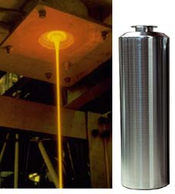
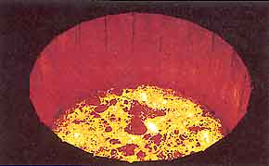
BOROSILICATE GLASSES AS WASTE FORMS FOR ACTINIDES AND FISSION PRODUCTS
Further conditioning of fuel debris for disposal
Classical waste glass melting
Unique host phase for Pu, U, minor actinides, fission and activation products
Vitrification by dissolving the debris to form a glass phase: Very high temperature melting required ( maybe by cold crucible technique?).
However: Vitrification provides no safety gain for geological disposal: actinide release is controlled by low actinide solubility in groundwater in a repository and not by glass dissolution rates.
Solubility of actinides in a repository environment do not decrease by vitrification.
The kinetics of mass transfer of remaining soluble radionuclides (I, Cs…) from vitrified debris to the environment may decrease
Cold crucible

Slide 17
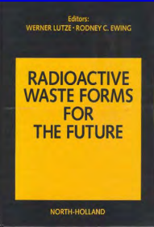
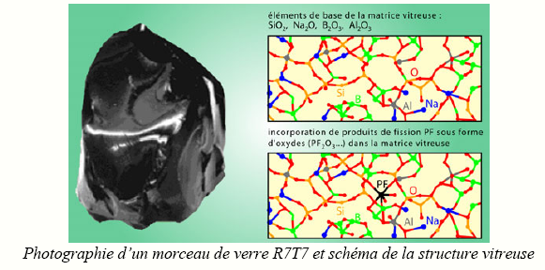
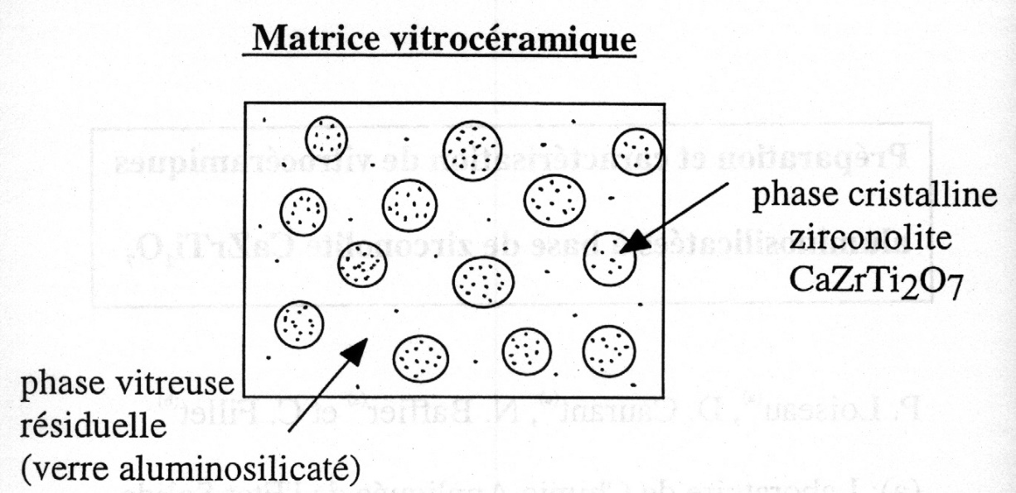
Differents ways for vitrification
Classical vitrification of HAW like in reprocessing by (1) dissolving all the debris in highly concentrated nitric acid, (2) calcination of the fluid and adding the calcinate together with glass forming constituents (Si, Al, Na…) (3) to the melter at about 1200°C by induction furnace or by a joule heated melter or at even higher temperature in a cold crucible melter ). Direct melting of fuel debris in glass melt may require too high temperatures?
The possible product:
Maybe fabricate a waste glasse by encapsulating small particulate fuel debris a glass matrix forming some kind of a glass ceramics. This would avoid the dissolution of the debris in nitric acid. These materials may also be produced by sintering. Work was done in the 80th, see Lutze and Ewing: Waste forms for the future (1988)
A glass ceramic matrix
Residual glassy matrix, composition may be adapted to needs of resistance, strength and durability
Photography of a piece of French R7T7 glass and a sketch for the confinement of radioactive chemical elements in the molecular glass structure

Slide 18


Only geological disposal provides the long term safety needed for multiples generations
Radiological risks for the very far future: Example geological disposal in clay formations of spent fuel.
DALY
/yr
(Japan
Average man/woman)
mSv/yr
Hiroshima
1000
100
10
1
0.1
0.01
0.001
0.0001
Tchernobyl
Evacuation order Fukushima
General public
Natural background radiation at disposal site
60 min
6 min
30 sec
3 sec
0.3 sec
Limit legal general population
Regulatory limit for radioactive waste disposal in France (CIGEO) = 0.3 mSv/yr
Risk during manipulation
Disposal: Maximal HLW/SF impact (case Nagra)
Deposition of clay rock formation from ancient oceans
¹²⁹I
Homo sapiens
pyramids
No impact
today
Risk from geologically disposed fuel debris may even be lower than that of spent fuel as the dose dominating ¹²⁹I (and probable ³⁶Cl) is already largely released in th accident and through cooling
Vitrified debris are unlikely to provide further safety gains compared to non vitrified containered debris

Slide 19
Conclusions
Comparing the fuel debris with spent nuclear fuel, the ‘washing’ of the fuel debris over many decades by cooling water may remove a much larger fraction of the more mobile radionuclides (¹²⁹I, ³⁶Cl, ¹³⁵Cs…) compared to that what is observed with spent nuclear fuel.
As the environmental impact of disposed spent nuclear fuel is largely linked to this more mobile nuclides, the direct disposal of fuel debris in suitable containers might be less restrictive or complicated than the direct disposal of spent nuclear fuel pursued in many countries.
Encapsulation of fuel debris in a glass matrix (vitrification) in a container may provide further handling and release stability and may retard the access of groundwater to the debris in case of disposal, but it is unlikely to reduce the long term risk further once disposed compared to none-vitrified debris
Confinement studies using simulated fuel debris may need to be pursued

Slide 20
A last word on past efforts to create a worldwide nuclear legacy initiative

Slide 21
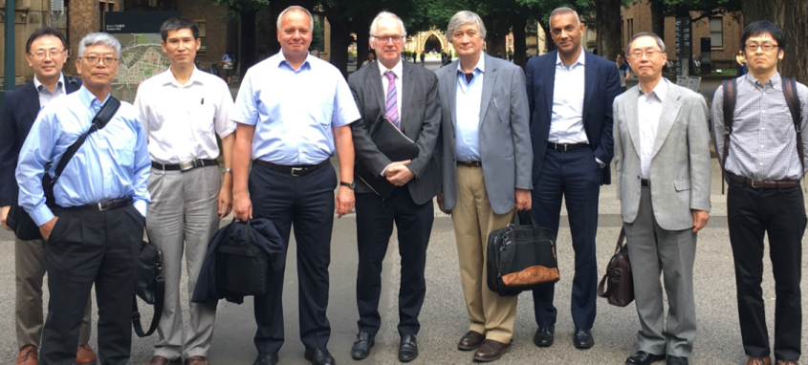
An attempt to start a global initiative …
Mobilisation of scientific community to work on nuclear legacy issues like in Japan is the base to build an IPCC like initiative, stopped after COVID crisis??
To help speeding up …
To have a long term vision…
To have a systems approach…
To be interdisciplinary and transdisciplinary
    Geosciences, radiochemistry, nuclear physics, medicine, toxicology, demography, history, sociology, landscape management…
    joint problem framing by social and natural sciences
To inform policies and regulations…
    How to attain Agenda 2030 and..
      the Sustainable Development Goals…
To have an internationally coordinated approach…
A number of meetings conducted in Tokai, Nantes, Tokyo with help of JAEA and the french
French Academy of Science, japaneze science council, ICSU (today ICS)

Slide 22
Nuclerar legacy initiative
Limit the nuclear legacy burden for our children
Vision
Impact
Actions
Science based and consensual approach on cleanup, increase efficiency in public spending, reducing the radiological and financial burden for future generations
Strategy
National governments develop more societally consensual, cost efficient and faster approach to nuclear legacy cleanup
Current conditions
Short term: Networking,
collaboration on science for cleanup,
Develop science for policy platform like IPCC as scientific exchange forum and a source of reliable information
1000 bn € multigenerational costs,
inefficient public spending
No societal consensus on radiological risks
Long term: Search political support
Report on nuclear legacy worldwide
Overcome the blockage in many nuclear legacy mega projects
Increase credibility and efficiency in public spending for rapidly reducing the burden for future generations.

